Slide 1
I’m Here!: A Practical Attendance Checking System using Smartphones
Final Presentation
Team 4
Chorom Hamm, Junghwan Lim, Yoojung Shin, Kwangwook Kwon

Slide 2
Before we start..
To participate in Demo if you want,
Download the android app(.apk) from the Direct link
http://52.79.226.66:8080/download

Slide 3
Overview of “I’m Here!”
Automatic attendance check system using students’ mobile device
No waste of time and paper
No cheating
Good reliability
Fundamental building blocks
Bluetooth Low Energy (BLE) scanning
Fingerprint authentication

Slide 4


Overview of “I’m Here!”
Register
Register device to server
MAC address, student name, etc..
(2) GetPlan
Send BLE sequence plan
(3) UploadFile
Uploads BLE measurement files
(4) FinalAttendance
Notify the result of clustering
Fingerprint authentication if possible
(1)Register
Waiting for all devices to be registered
(2)GetPlan
Performs BLE measurement
(3)UploadFile
Clustering
(4) FinalAttendance

Slide 5
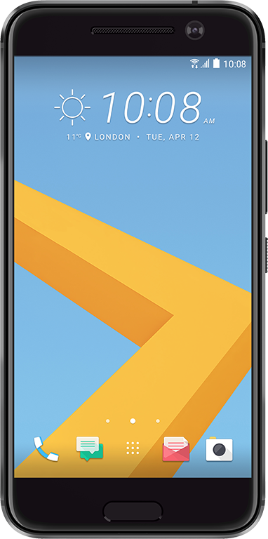
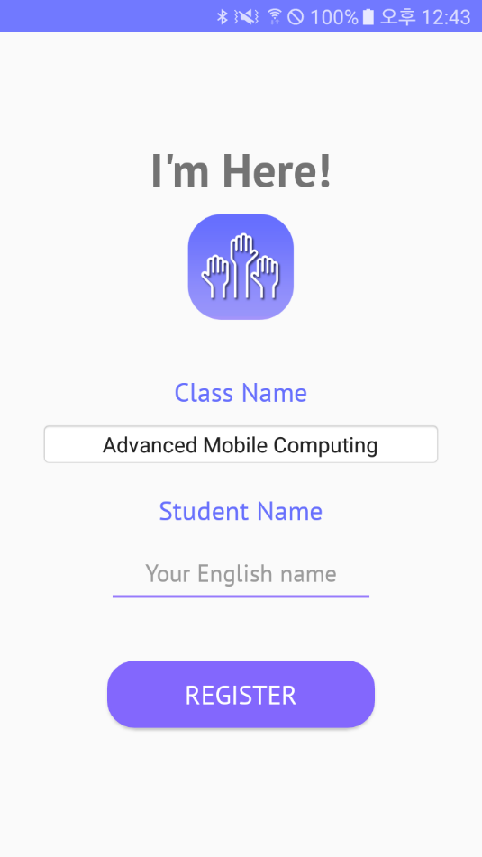

I’m Here! Application

Slide 6
Details of the Application
The client sends several request to the server with an http message
Registration
Class name, student name and MAC address of device
BLE (Bluetooth Low Energy) signal exchange
Timestamp, MAC address of the scanned device, RSSI (Received Signal Strength Indicator), TX (Transmit) power

Slide 7
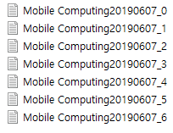

Details of the Application
Upload
Text files contacting scan information
Authentication
Fingerprint recognition result
Server

Slide 8
Details of the Application
Device variety
If the device does not provide the fingerprint recognition function, the process is performed except for the fingerprint recognition

Slide 9
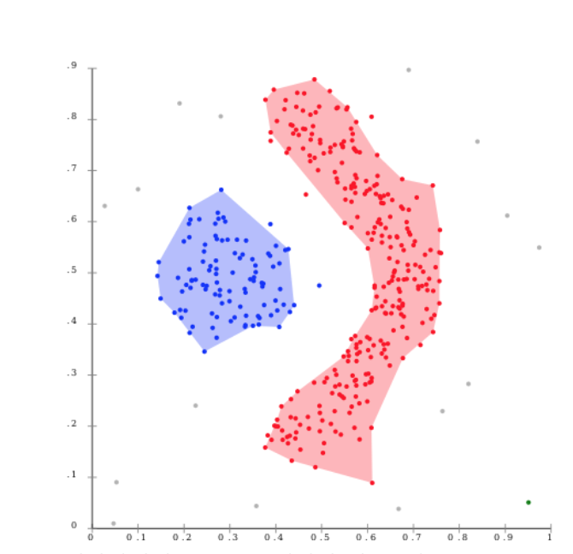
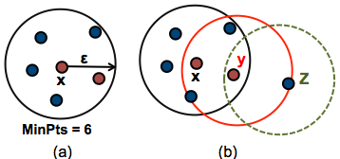
Clustering
Cluster points by a density-based clustering (DBSCAN)
Assume that students sit close to each other
- A point p is a core point if at least MinPts points are within distance ε of it
- A point q is a border point if it is reachable from core point p

Slide 10

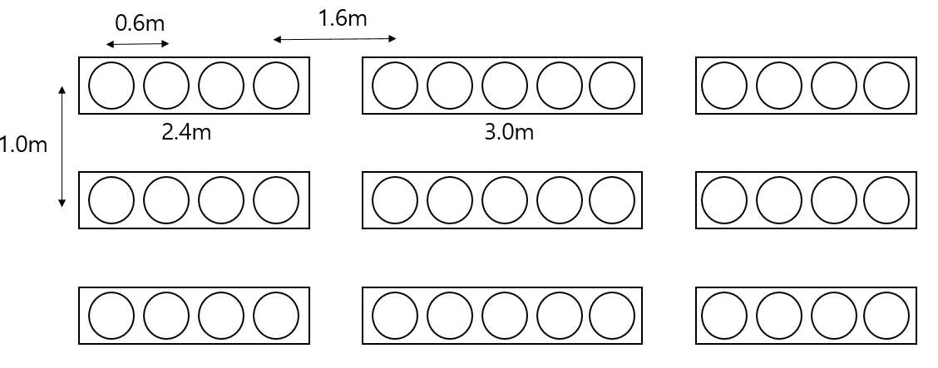
Make it Scalable
Simulate attendance check test by randomly distributing points, calculating distance of each other, and clustering them
Testbed
- 302 Building, Room 105
- Approximately 14 X 13 (182 seats)

Slide 11
Find Number of Transmit Points
In order to reduce the execution time, find the number of points which are selected to transmit signals among all points
Test by adjusting # of students in class and # of transmit points
Each point’s transmit time: 10 secs
Signal range: 10 m
# of students
 | 100% | 90% | 75% | 60% | 50%
100% | 1.000 (1820) | 1.000 (1630) | 1.000 (1360) | 1.000 (1090) | 1.000 (910)
25% | 1.000 (450) | 1.000 (400) | 1.000 (340) | 1.000 (270) | 1.000 (220)
10% | 1.000 (180) | 1.000 (160) | 1.000 (130) | 1.000 (100) | 1.000 (90)
5% | 1.000 (90) | 0.998 (80) | 0.980 (60) | 0.951 (50) | 0.882 (40)
Success ratio (time in secs)
# of transmit points

Slide 12
Success Criteria
Does it work well? (User Experience)
Does it consume a reasonable amount of energy?
Can it discriminate absence from attendance? (accuracy)
Can it work well when there are lots of students? (scalability)
It can spend only 3 to 5 minutes by choosing 10 ~ 25% students to transmit

Slide 13
Thank you

